Slide 1
Structured Query Language

Slide 2
Chapter five
SQL(structured quary language)
SQL is a standard language for accessing and manipulating databases.
SQL stands for Structured Query Language
SQL lets you access and manipulate databases
What Can SQL do?
SQL can execute queries against a database
SQL can retrieve data from a database
SQL can insert records in a database
SQL can update records in a database
SQL can delete records from a database

Slide 3
Con….
SQL can create new databases
SQL can create new tables in a database
SQL can create stored procedures in a database
SQL can create views in a database
SQL can set permissions on tables, procedures, and views
Keep in Mind That...
SQL is not case sensitive

Slide 4
SQL DML and DDL
SQL can be divided into two parts:
Data Manipulation Language (DML) and
Data Definition Language (DDL).
The DDL part of SQL permits database tables to be created or deleted. The most important DDL statements in SQL are:
CREATE DATABASE - creates a new database
ALTER DATABASE - modifies a database
CREATE TABLE - creates a new table
ALTER TABLE - modifies a table
DROP TABLE - deletes a table

Slide 5
Con..
The query and update commands form the DML part of SQL:
SELECT - extracts data from a database
UPDATE - updates data in a database
DELETE - deletes data from a database
INSERT INTO - inserts new data into a database

Slide 6
Creating a database
To create a database:
Example:
create a database is called ‘myfirstdatabase’.
create database myfirstdatabase
What if you want to delete the database?
You don’t use delete database as you might expect , instead you use the drop database statement followed by the database name.
So to drop the myfirstdatabase you write the following:
Create database [databasename]
drop database myfirstdatabase

Slide 7
Con…
After creating a database, the next stage is to add tables to it.
CREATE TABLE - Define the structure of a new table.
Example: Define the student table
CREATE TABLE student
( stud_id CHAR(5),
fname varCHAR(10) NOT NULL,
lname varCHAR(8),
marks INTEGER,
dep varchar(15)
PRIMARY KEY (stud_id))

Slide 8
con…
Exrecise
Create one table named video with four attribute in database1

Slide 9
Deleting table:
Drop table TableName
.how to delete the table created in the above?
Drop table student

Slide 10
Changing the structure of the table
Renaming column
sp_rename 'TableName.ColumnName', 'NewColumnName', 'COLUMN'
Example:
Change the column name ‘fname’ by ‘firstname’.
sp_rename ‘STUDENT.fname’,’firstname’,’column’

Slide 11
Insert data:
INSERT INTO TableName
VALUES (Column1, Column2, Column_n)
Example:
Insert Into student
values (‘E001’,'Fikadu','Mulisa',25,’math’)

Slide 12
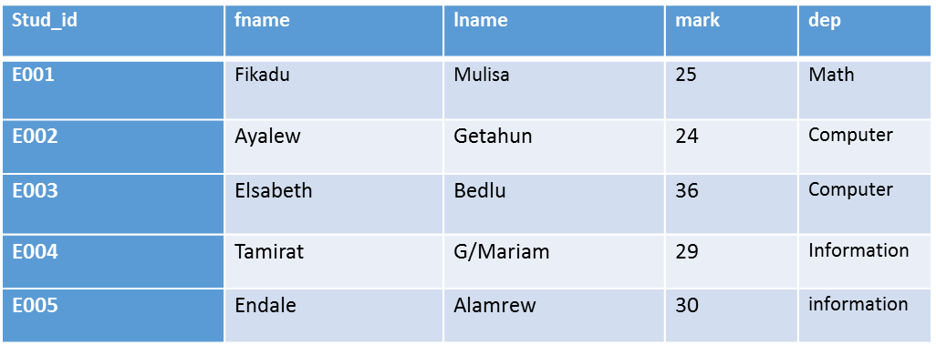
Con…
Exercise:
Insert the values below for each row respectively in student table.

Slide 13
Con…
Insert into student
values(‘E003’,’Elsabeth’,’Bedlu’,36)…………………
Student table:

Slide 14
Insert Data Only in Specified Columns
It is also possible to only add data in specific columns.
The following SQL statement will add a new row, but only add data in the ‘stud_id’, ‘fname’ and the “lname" columns:
INSERT INTO student (stud_id, firstname,lname)
VALUES (‘E006’, 'Teja', ‘yakob')
Ans:

Slide 15
SELECT:
Used primarily to retrieve data from the database.
Also used to create copies of tables, create views, and to specify rows for updating.
There are several variations are available:
SELECT {field-list | * | ALL | DISTINCT | expression}
FROM table-list
WHERE expression
GROUP BY group-fields
HAVING group-expression
ORDER BY field-list;

Slide 16
Con…
Only the SELECT and the FROM clauses are required. The others are optional.
FROM - A required clause that lists the tables that the select works on.
WHERE - An optional clause that selects rows that meet the stated condition.
A "sub-select" can appear as the expression of a where clause.
This is called a "nested select".
GROUP BY - An optional clause that groups rows according to the values in one or more columns and sorts the results in ascending order (unless otherwise specified).

Slide 17
Con…
HAVING - An optional clause that is used with GROUP BY.
It selects from the rows that result from applying the GROUP BY clause.
ORDER BY - An optional clause that sorts the final result of the SELECT into either ascending or descending order on one or more named columns.
There can be complex interaction between the WHERE, GROUP BY, and HAVING clauses. When all three are present the WHERE is done first, the GROUP BY is done second, and the HAVING is done last.

Slide 18
Con…
Example 1: Select all student from the ‘computer’ department.
SELECT *
FROM student
WHERE dep = ‘computer'
Ans:

Slide 19
Con…
Example 2: Retrieve all information about students ('*' means all attributes)
select *
from student
Ans:

Slide 20
Con…
Example 3: Find the student id, first name and last name of all students.
select stud_id,firstname,lname
from student
Ans:

Slide 21
Con..
Example 4: Find the student ID of all information department.
Select stud_id
From student
Where dep=‘information’
Ans:

Slide 22
Con…
Example 5: Retrieve a list of all departements that currently have students.
select distinct dep
from student
NOTE: the key word DISTINCT used to remove duplicated values.
Ans:

Slide 23
A Combination or Expression of Columns
SELECT column name1 + ' ' + column name2
FROM table name
NOTE: the columns are must have the same data types.
Example 6: combine the two columns ‘fname’ and ‘lname’.
SELECT firstname + ' ' + lname
FROM Student
Ans:

Slide 24
Con…
Example 7: combine the two columns fname and lname and give the name ‘full Name’.
SELECT firstname + ' ' + lname AS 'Full Name',
FROM Student;
Ans:

Slide 25
Con…
Example 8: retrieve the value of column ‘dep’ and give the name to the field called ‘department’.
SELECT department = dep
FROM Student
NOTE: dep➔ is the fieldname in the table
Ans:

Slide 26
Quotes Around Text Fields
SQL uses single quotes around text values (most database systems will also accept double quotes).
Although, numeric values should not be enclosed in quotes.
For text values:
This is correct:
SELECT * FROM student WHERE firstame=‘Ayalew'
This is wrong:
SELECT * FROM student WHERE firstname=Ayalew

Slide 27
Con…
For numeric values:
This is correct:
SELECT * FROM student WHERE mark=1965
This is wrong:
SELECT * FROM student WHERE mark='1965'

Slide 28
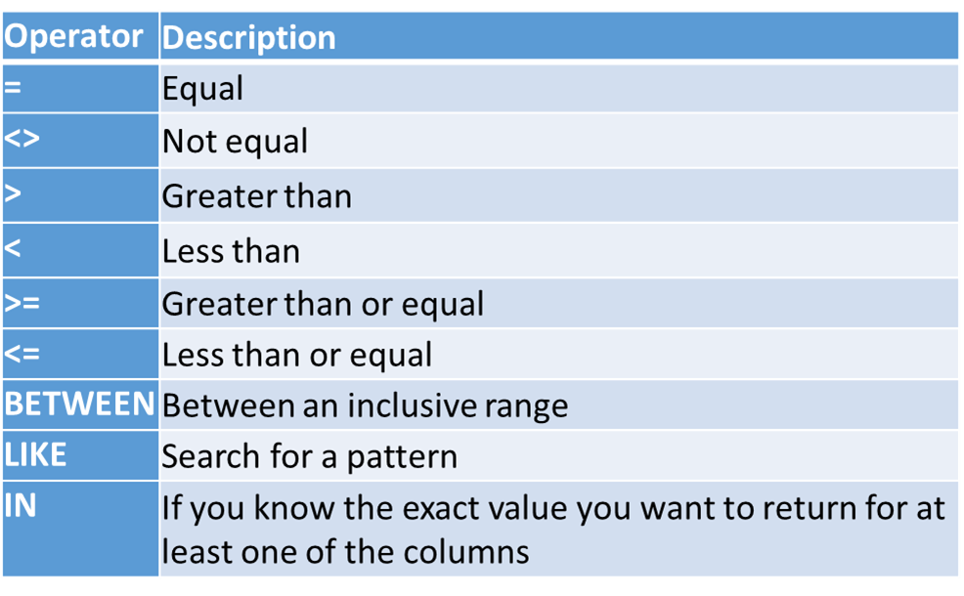
Operators Allowed in the WHERE Clause
Note: In some versions of SQL the <> operator may be written as !=

Slide 29
Con…
Example 9:retrieve all information about student the last name is bedlu and also the department is computer.
We use the following SELECT statement:
SELECT * FROM student
WHERE lname=‘bedlu‘ AND dep=‘computer‘
Ans:

Slide 30
OR Operator Example
Example 9:retrieve all information about student the last name is bedlu or the student that allow in information department.
We use the following SELECT statement:
SELECT * FROM student
WHERE lname=‘bedlu' OR dep=‘information’
Ans:

Slide 31
Combining AND & OR
Example 9:retrieve all information about student the last name is bedlu and also the department is computer or information.
We use the following SELECT statement:
SELECT * FROM student
WHERE lname='bedlu’
AND (dep='computer' OR dep='information')
Ans:

Slide 32
SQL ORDER BY Keyword
The ORDER BY keyword is used to sort the result-set.
The ORDER BY keyword sort the records in ascending order by default.
If you want to sort the records in a descending order, you can use the DESC keyword.
SELECT stud_id,firstname,dep
FROM student
ORDER BY firstname desc

Slide 33
Con…
Ans:

Slide 34
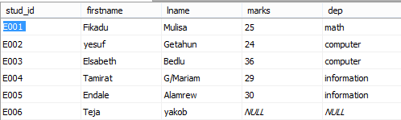
SQL UPDATE Statement
The UPDATE statement is used to update records in a table.
UPDATE student
SET firstname=‘yesuf’
WHERE stud_id=‘E002’
Ans:

